Slide 1
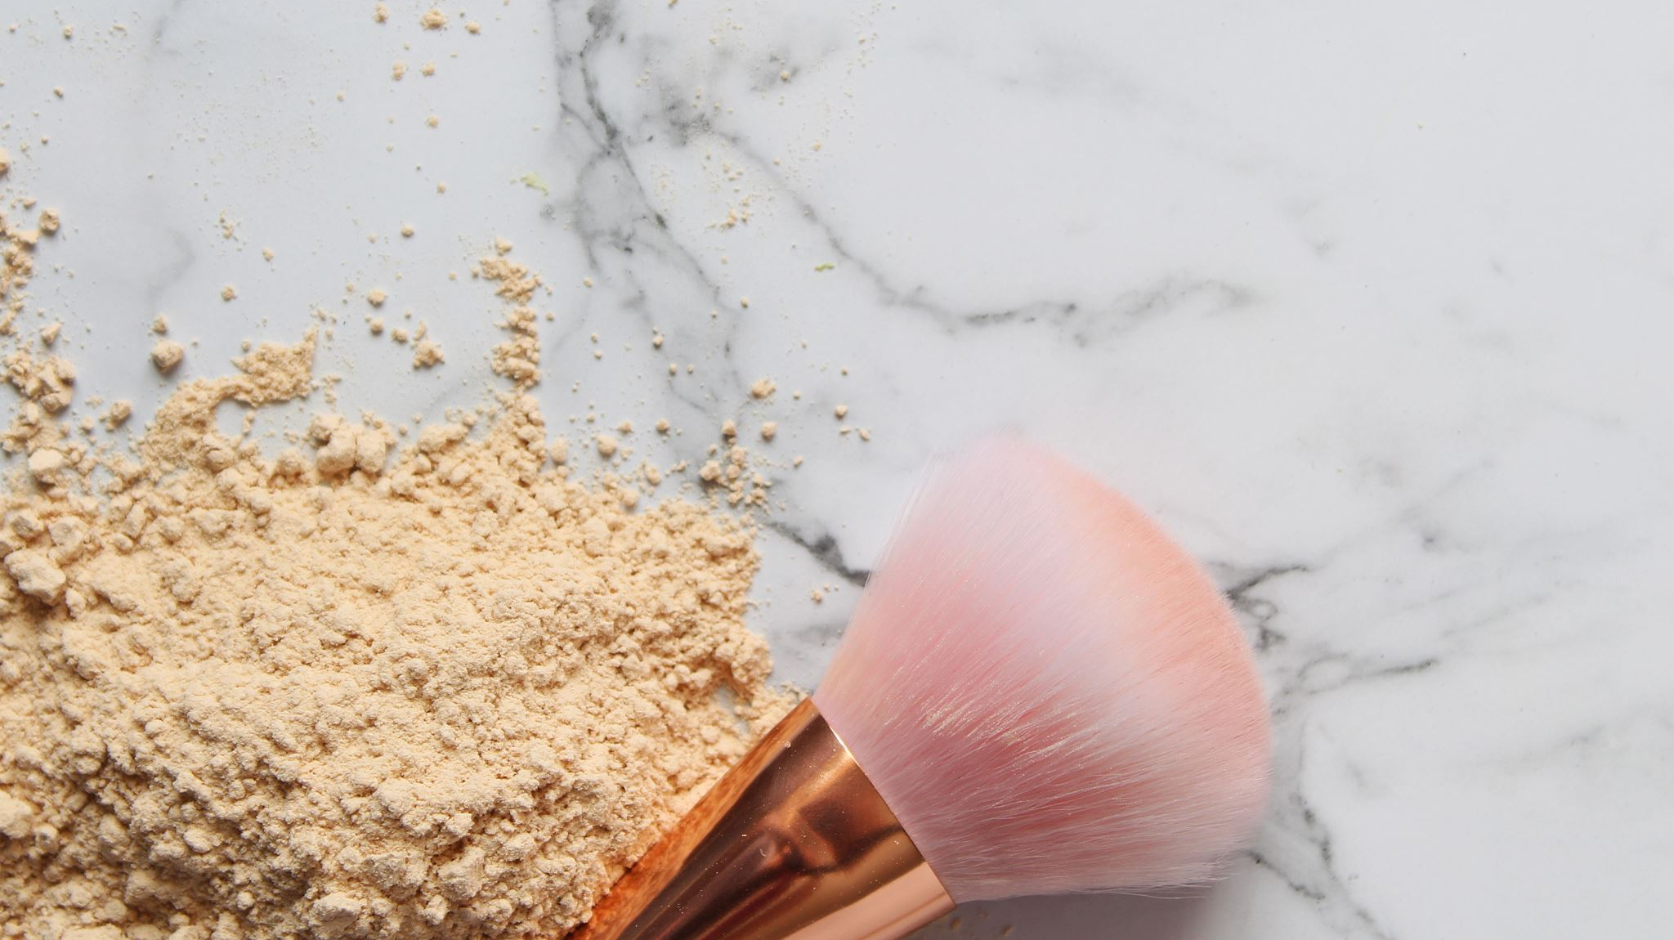
Cosmetics products and their price
By Liron Dahan and Amit Hadad

Slide 2
Introduction- Research questions
Predict future price of cosmetics product

Slide 3

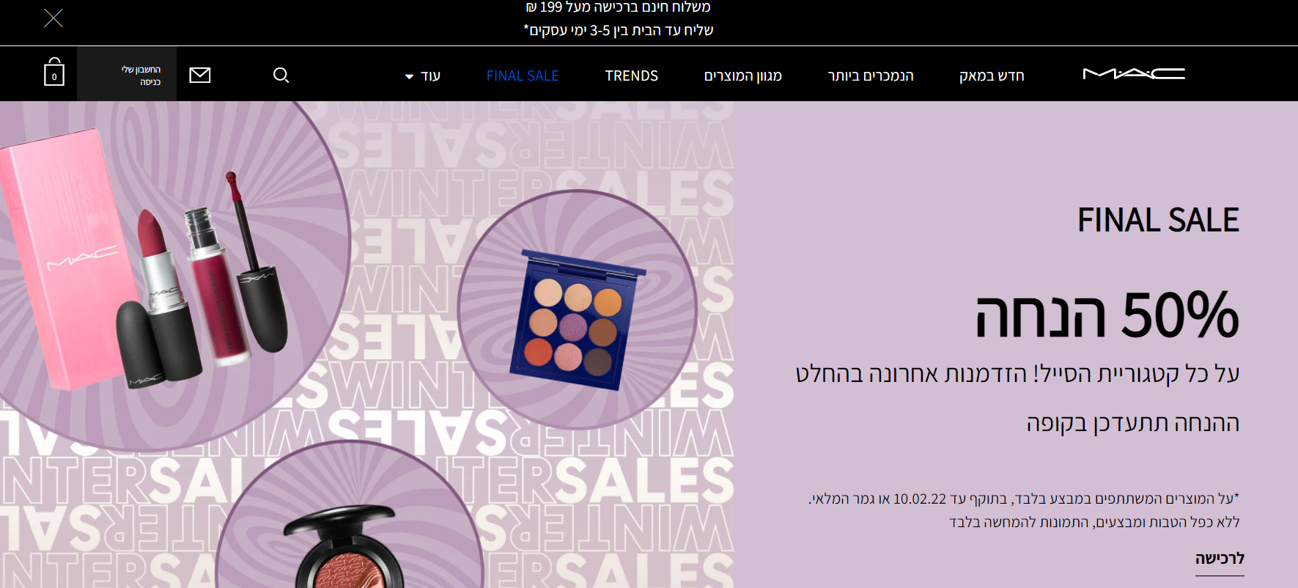
We crawling relevant item in Mac website with ‘beautifulsoup’ and saving the data into a file ‘a_file2’ then into dataframe - df
MAC -crawling

Slide 4
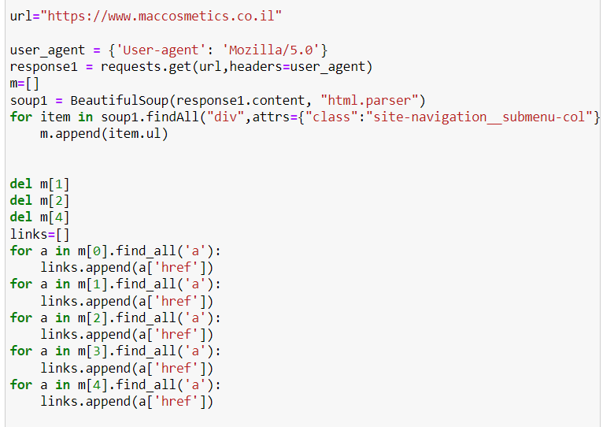
MAC -crawling
We start the parsing by category of the product , and taking all the html

Slide 5
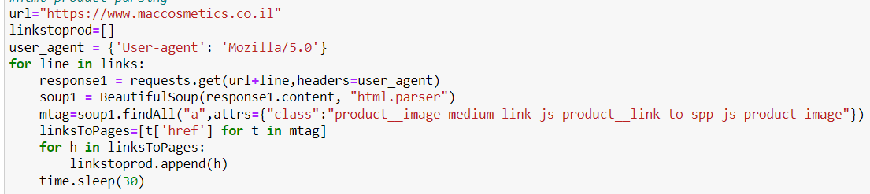
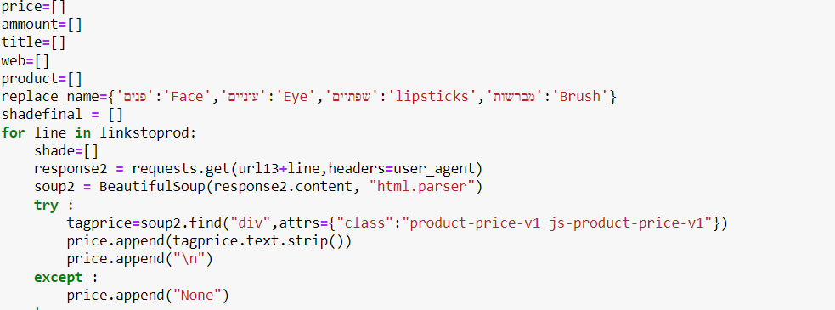
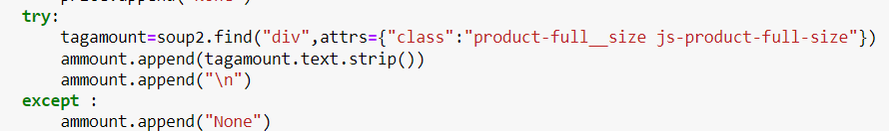
MAC -crawling
Then we get into the page and take details on the product such as title, amount and etc.
This is example of taking amount of the product
Then we save all of this into file for not doing this crawling over again

Slide 6
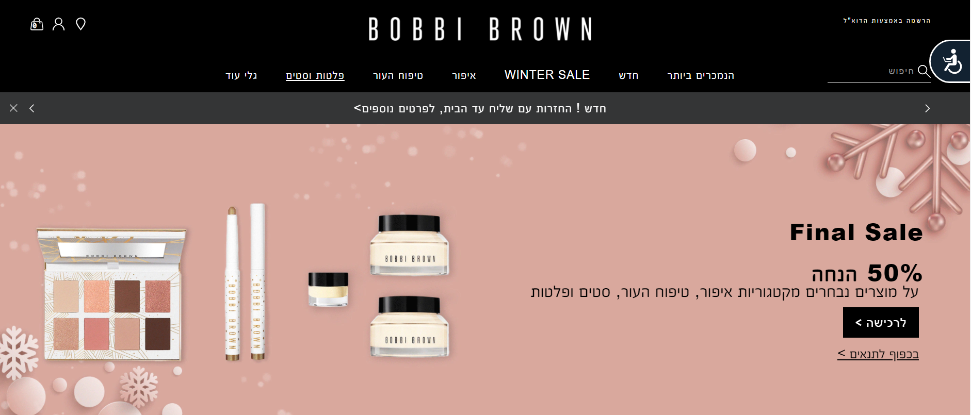
Bobbi Brown - crawling
Another website that we are crawling their product and we save the dataframe into df2.
After we take all the data we clean and check the data.

Slide 7
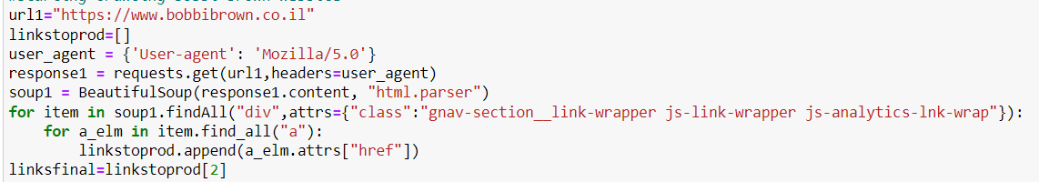
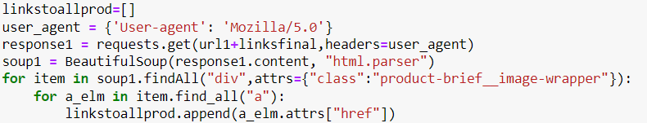
Bobbi Brown - crawling
The process of this website is the same of mac
First we took all the links of product by category
Then we parsing every html page

Slide 8
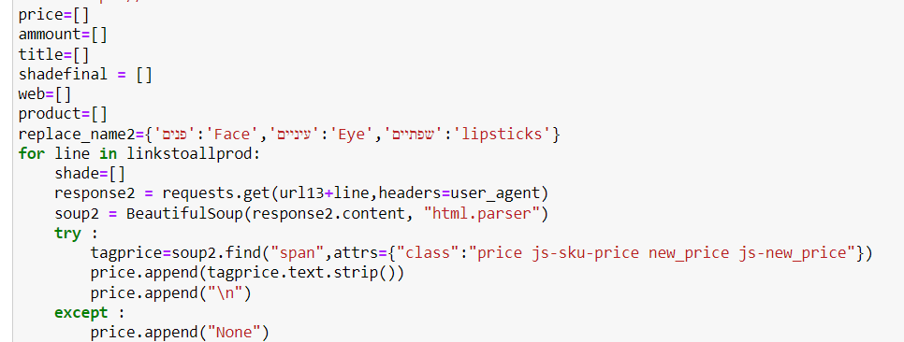
Bobbi Brown - crawling
After we got all the links we started to take all the properties of the product
There is example of taking price of all the product

Slide 9


Combine the dataframe
For the final data we merge the two dataframe into one

Slide 10
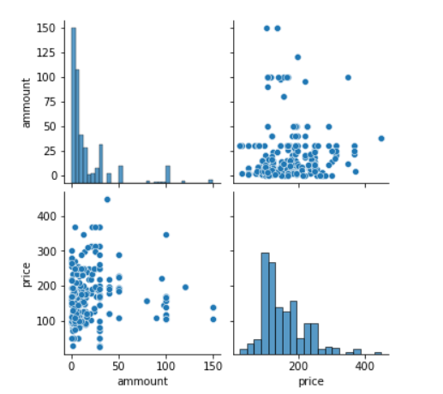
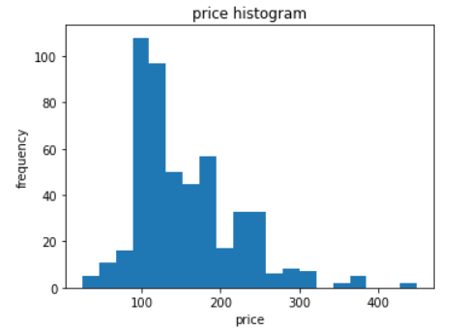
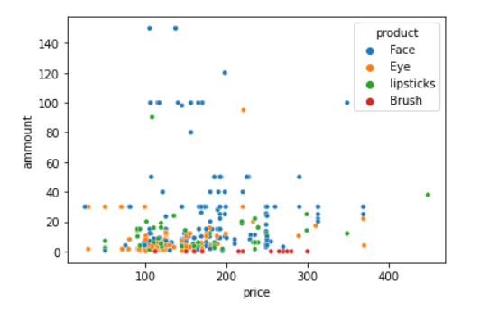
Visualization the dataframe
we start to analyze the dataframe and see it more visual

Slide 11
Machine Learning – linear regression
We use `sklearn` library and linear regression to be able to train a model that predicts the price of product and we try some methods of linear regression, such as R2, sse and etc.

Slide 12
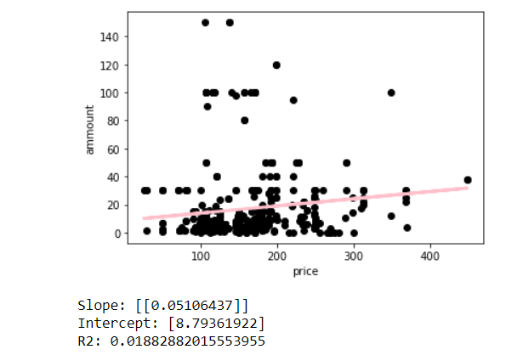
We can see the result on scatter plot

